Slide 1
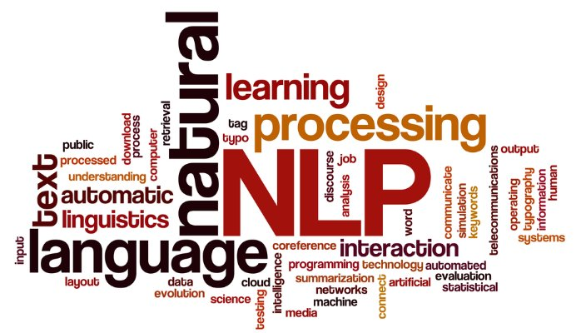
Text Vectorization in NLP
Dr. Ignatius Ezeani
Monday, 08 March 2021
Notes:
Hello every one, Welcome to the 2nd lecture from the NLP part of this module SCC.413.
In this lecture, we will

Slide 2

Lecture Outline
This lecture is structured in three parts:
Part 1:
Review of last Lecture + Lab
Part 2
Overview of Text Preprocessing
Bag of Words (BoW) Models
TF.IDF
Part 3
Neural Networks for Texts
Embedding Models

Slide 3

Intended Learning Outcomes
At the end of this lecture, you should be able to
perform basic pre-processing on text
explain the concept of text vectorisation
explain classical feature extraction methods such as BoW and TF.IDF
discuss the fundamentals of word embedding

Slide 4
Summary of Week 18
In Week 18, we covered the following
What is NLP and why do we need it?
Why is NLP hard?
Common Tasks in NLP
Applying Machine Learning to NLP Tasks
Basic Text Feature Extraction
Lab Exercise: Simple Classification Tasks
Gender Identification and Movie Reviews

Slide 5
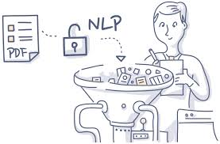
What is NLP and why do we need it?
What is NLP?
The study of the computational processing of human language which creates systems that understand and generate human language
Why NLP?
Zettabytes of human language data (~44Zb) (~44ZettaBytes) on the internet
Need for efficient tools and techniques to make sense of them as well as generate actionable outputs

Slide 6

Why is NLP hard?
Human language is ambiguous
Iraqi Head Seeks Arms (head and arms are ambiguous)
Language is subtle
Language representations are unique to their domains
Language evolves – changes over time
~ 7000 human (living) languages

Slide 7


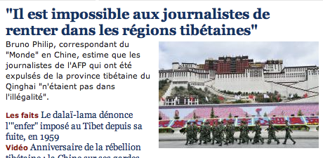
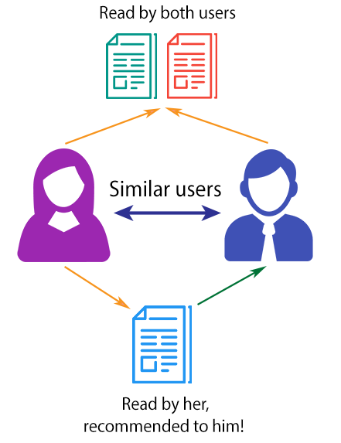

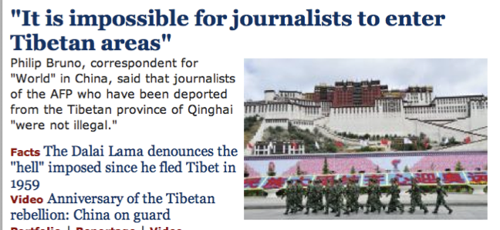




Common Tasks in NLP
Parts-of-Speech Tagging
Words Sense Disambiguation
Text Classification
Machine Translation
Named-Entity Recognition
Information Extraction
“Spoken” Language Systems

Slide 8
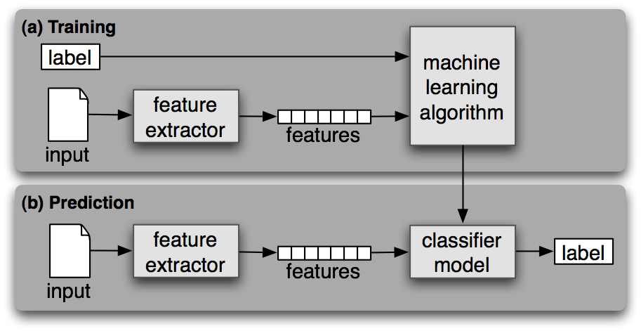
Supervised ML for Text
A computer learns from experience E with respect to task T and some performance measure P, if its performance on T, as measured by P, improved with experience E”
Key components
input (training) data (instances)
Correct labels
Feature extractor
Machine learning algorithm
Classifier model

Slide 9
Feature Extraction
Features are the key ingredients for creating data instances for training machine learning models
Feature extraction in NLP involves detecting patterns in text that can help in building an accurate model.
POS-tagging: Words ending in -ed tend to be past tense verbs.
Document classification: Frequent use of will is indicative of news text
A feature extractor is a function that converts each input value to a feature set.

Slide 10
Preprocessing, BoW and TF.IDF
See an extended list of NLP tasks: https://nlpprogress.com/

Slide 11
Focusing on Text Classification…
Example: sentiment analysis
Input:
text of review
Output:
class of sentiment
Classes
Binary (i.e. 2 classes): positive vs negative
Fine-grained: positive, somewhat positive, neutral, somewhat negative, negative

Slide 12
Focusing on Text Classification…
Positive example:
The hotel is really beautiful. Very nice and helpful service at the front desk.
Negative example:
We had problems to get the Wi-Fi working. The pool area was occupied with young party animals. So the area wasn’t fun for us.

Slide 13
What is text?
Text, in this context, could be taken as a sequence of
characters
words
phrases and named-entities
sentences
paragraphs
etc
Notes:
It seems natural to think of a text as a sequence of words

Slide 14
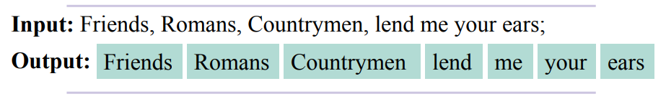
What is a word?
A word is a “meaningful” sequence of characters
In English, we can split a sentence by spaces of punctuations
In German, compound words are written without space:
Rechtsschutzversicherungsgesellschaften means
“insurance companies that provide legal protection”
Japanese has no spaces at all!
Butyoucanstillreaditright?
しかしあなたはまだそれを正しく読むことができますか？

Slide 15
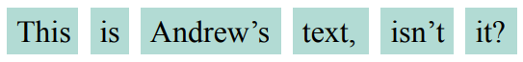
Tokenization: WhitespaceTokenizer
One major pre-processing task is tokenisation i.e. splitting an input sequence into tokens.
A token is a useful unit for semantic processing, and can be words, sentences, paragraphs, etc
Example: nltk.tokenize.WhitespaceTokenizer
Input text: “This is Andrew’s text, isn’t it?”
Output:
Problem:
Punctuations attached to words, inflates the dictionary
e.g. “it” == “it?”

Slide 16
Tokenization: WordPunctTokenizer
Using different tokenizers gives different results
Example: nltk.tokenize.WordPunctTokenizer
Separates the punctuations
Input text: “This is Andrew’s text, isn’t it?”
Output:
Problem:
Creates strange words: “s”, “isn”, “t” are not very meaningful

Slide 17
Tokenization: TreebankWordTokenizer
Example: nltk.tokenize.TreebankWordTokenizer
Separates the punctuations
Input text: “This is Andrew’s text, isn’t it?”
Output:
Output looks better
“s”, and “n’t” seem more meaningful

Slide 18
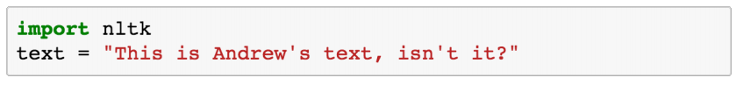
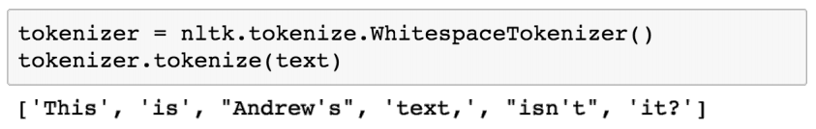
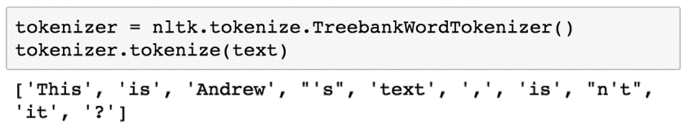
Tokenization: Python example

Slide 19
Token Normalisation
This is the process of transforming variants of a token into a common form that retains its meaning
It is an essential pre-processing step that reduces variations in word forms to common that mean the same thing
US, U.S.A → USA
wolf, wolves → wolf
talk, talks, talked→ talk
Two common normalisation method:
stemming and lemmatization

Slide 20
Stemming
Stemming refers to the process of removing and replacing suffixes to get to the stem (i.e. root form) of the word
Sequentially applied heuristics that chop off suffixes
Example: nltk.stem.PorterStemmer
feet → feet cats → cat
wolves → wolv talked → talk
Problem:
fails on irregular forms
Produces non-words
Rule | Example
SSES → SS | caresses → caress
IES → I | Ponies → poni
SS → SS | caress → caress
S → | cats → cat

Slide 21
Lemmatization
Applies vocabulary and morphological analysis to a word to return the lemma i.e. base or dictionary form of a word
Example – nltk.stem.WordNetLemmatizer
feet → foot cats → cat
wolves → wolf talked → talked
Problems:
Not all forms are reduced
It may worth trying both to see which is better for the task.
Normalizations on capitalization or acronyms are also common

Slide 22
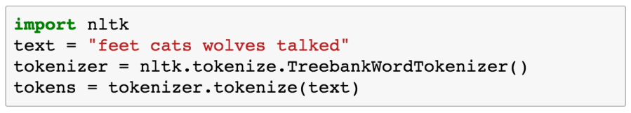
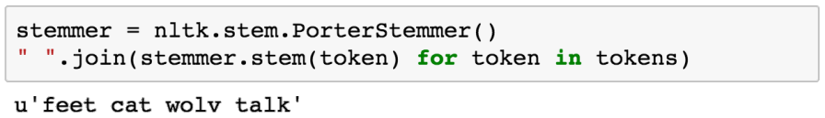
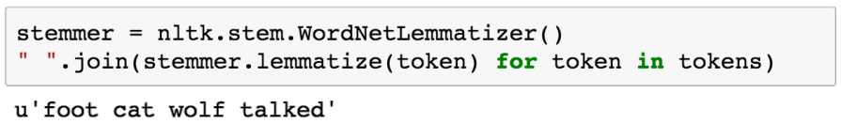
Stemming: Python Example

Slide 23
Transforming Tokens to Features
Machine Learning RoadMap YouTube

Slide 24
Recall - Feature Extraction
Features are the key ingredients for creating data instances for training machine learning models
Text feature extraction refers to detecting patterns in text that can help in building an accurate model.
POS-tagging: Words ending in -ed tend to be past tense verbs.
Document classification: Frequent use of will is indicative of news text
We can achieve this with text vectorization

Slide 25
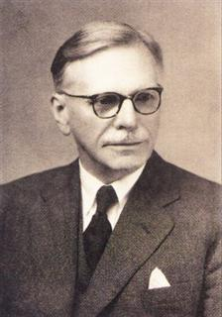
Meaning in Context
One of the most successful ideas in modern NLP is that the meaning of a word is determined by it’s context.
The foundational assumption was proposed by the linguist John Rupert Firth in 1957
“You shall know a word by the company it keeps” – Firth J.R. 1957:11
We gain a lot by representing a word in terms of its neighbours

Slide 26
Text Vectorisation
Machine learning algorithms most often take numeric feature vectors as input.
Working with text documents, we convert each document into a numeric vector.
This representation format is known as text vectorization.
Text vectorization aims to capture the semantic relationship between a word and other words in similar context

Slide 27
Approaches to Text Vectorization
Localist approach
Assign token_ids
Use 1-Hot vector
Bag of Words (BoW)
Term Frequency – Inverse Document Frequency (TF-IDF)
Word Embedding
Word2Vec
Glove
Similarity (distance) measure
Cosine distance
Euclidean distance

Slide 28
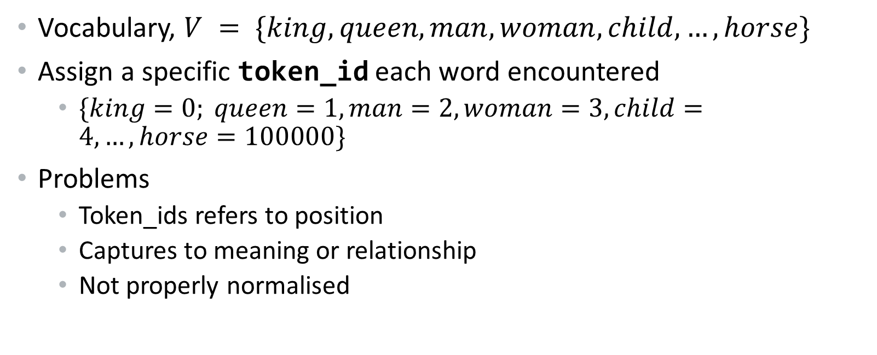
Assign token_ids to words
Vocabulary, $V = \{king, queen, man, woman, child, …,horse\}$
Assign a specific token_id each word encountered
$\{king=0; queen=1, man=2, woman=3, child=4,…,horse=100000\}$
Problems
Token_ids refers to position
Captures to meaning or relationship
Not properly normalised

Slide 29
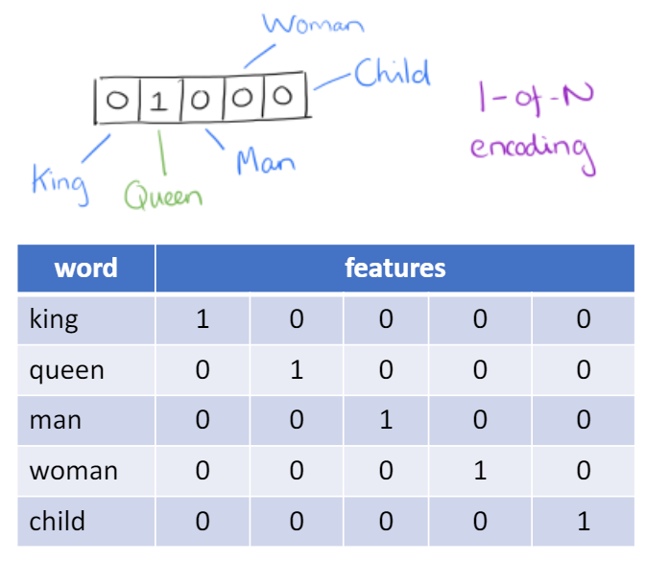
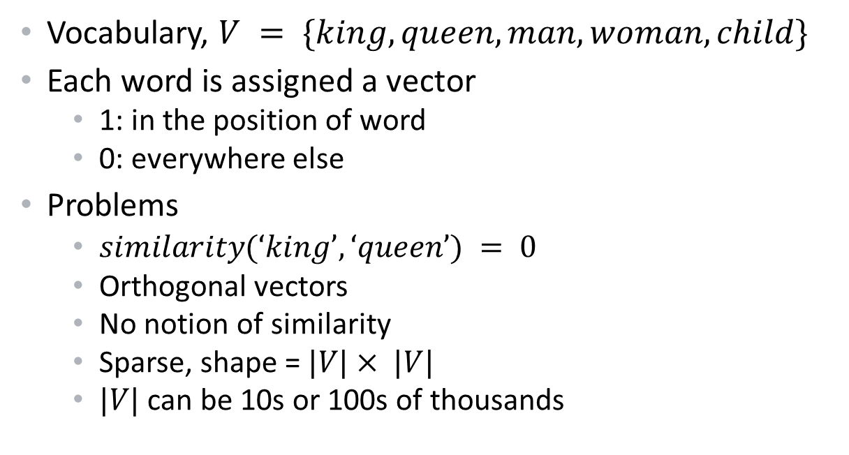
1 – Hot Vector
Vocabulary, $V = \{king, queen, man, woman, child\}$
Each word is assigned a vector
1: in the position of word
0: everywhere else
Problems
$similarity(‘king’, ‘queen’) = 0$
Orthogonal vectors
No notion of similarity
Sparse, shape = $|V|× |V|$
$|V|$ can be 10s or 100s of thousands

Slide 30
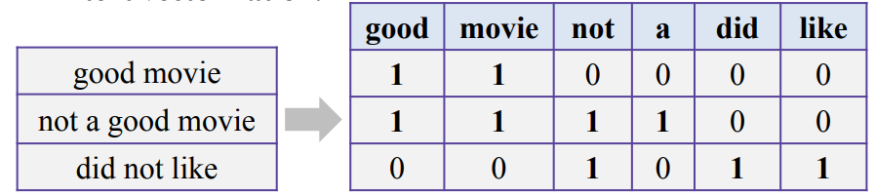
Bag of Words (BoW)
Bag of words represents the counts of occurrences of particular tokens in the text
Example, in the movie review text
Problems:
The order of words are not preserved, hence bag of words
counters are not normalized

Slide 31
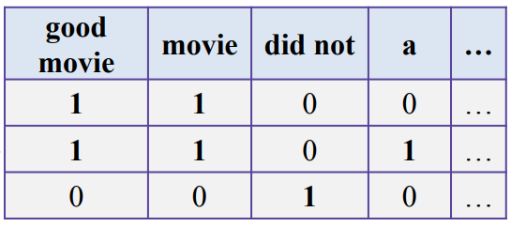
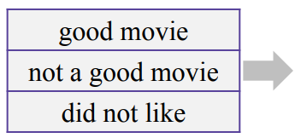
Bag of Words (BoW)
To preserve some ordering, we can count n-grams
e.g word pairs (bigrams) or triples (trigrams)
Problem
Too many features

Slide 32
Reducing the number of features
Remove some n-grams from features based on their occurrence frequency in documents of our corpus
High frequency n-grams:
stopwords: Articles, prepositions, etc. (e.g: and, a, the)
They won’t help us to discriminate texts à remove them
Low frequency n-grams:
Typos, rare n-grams
We don’t need them either; will likely overfit
Medium frequency n-grams:
We need to focus on these n-grams

Slide 33
Reducing the number of features
It proved to be useful to look at n-gram frequency in our corpus for filtering out bad n-grams
What if we use it for ranking of medium frequency n-grams?
Hint: n-gram with smaller frequency can be more discriminating because it can capture a specific issue in the review

Slide 34
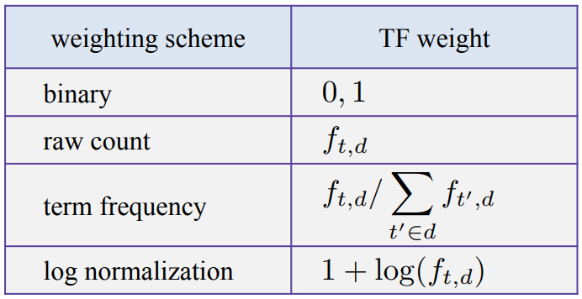
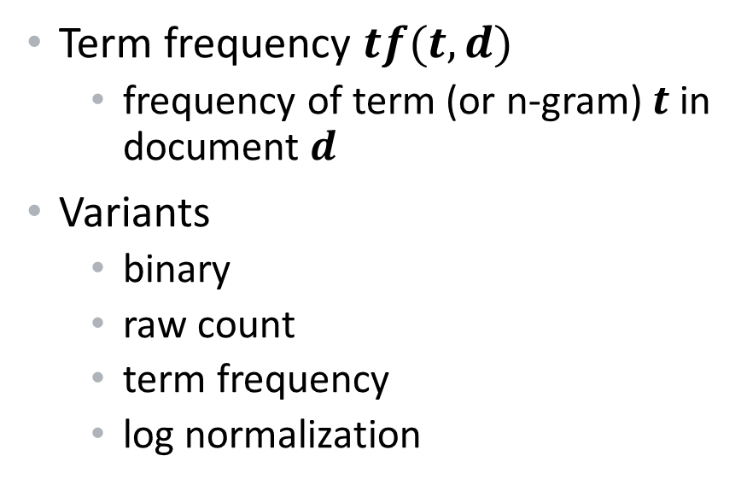
Term Frequency (TF)
Term frequency $tf(t,d)$
frequency of term (or n-gram) $t$ in document $d$
Variants
binary
raw count
term frequency
log normalization

Slide 35
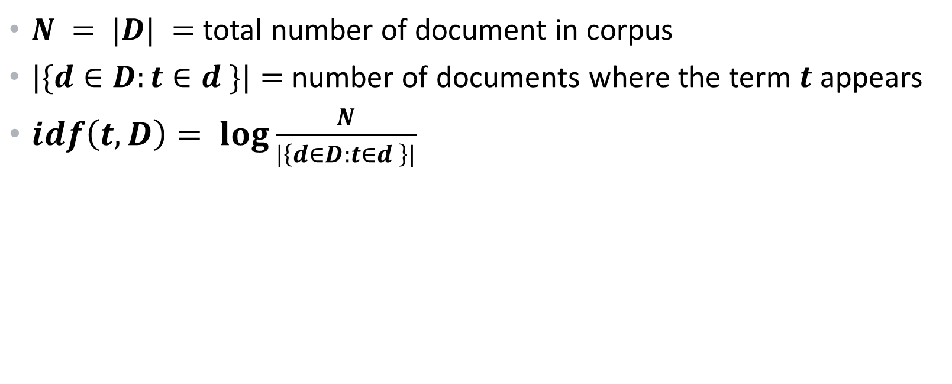
Inverse Document Frequency (IDF)
$N = |D| =$total number of document in corpus
$|\{d∈D:t∈d \}|=$number of documents where the term $t$ appears
$idf\left(t,D\right)= \log{\frac{N}{|\left\{d∈D:t∈d \right\}|}}$

Slide 36
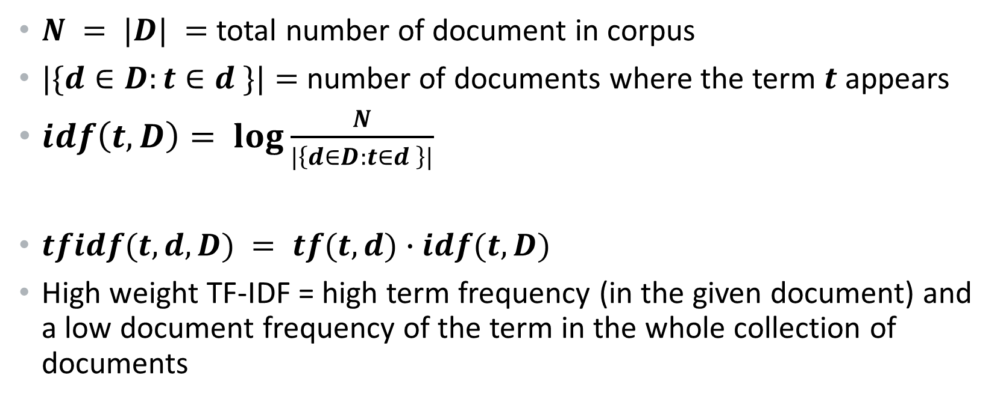
TF-IDF
$N = |D| =$total number of document in corpus
$|\{d∈D:t∈d \}|=$number of documents where the term $t$ appears
$idf\left(t,D\right)= \log{\frac{N}{|\left\{d∈D:t∈d \right\}|}}$
$tfidf(t,d,D) = tf(t,d)∙idf(t,D)$
High weight TF-IDF = high term frequency (in the given document) and a low document frequency of the term in the whole collection of documents

Slide 37
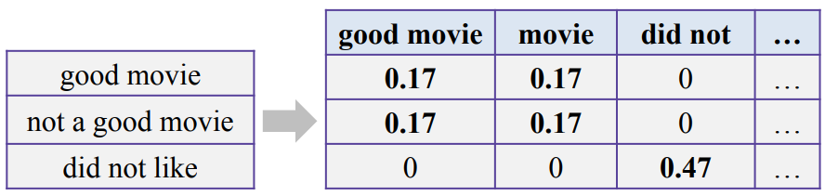
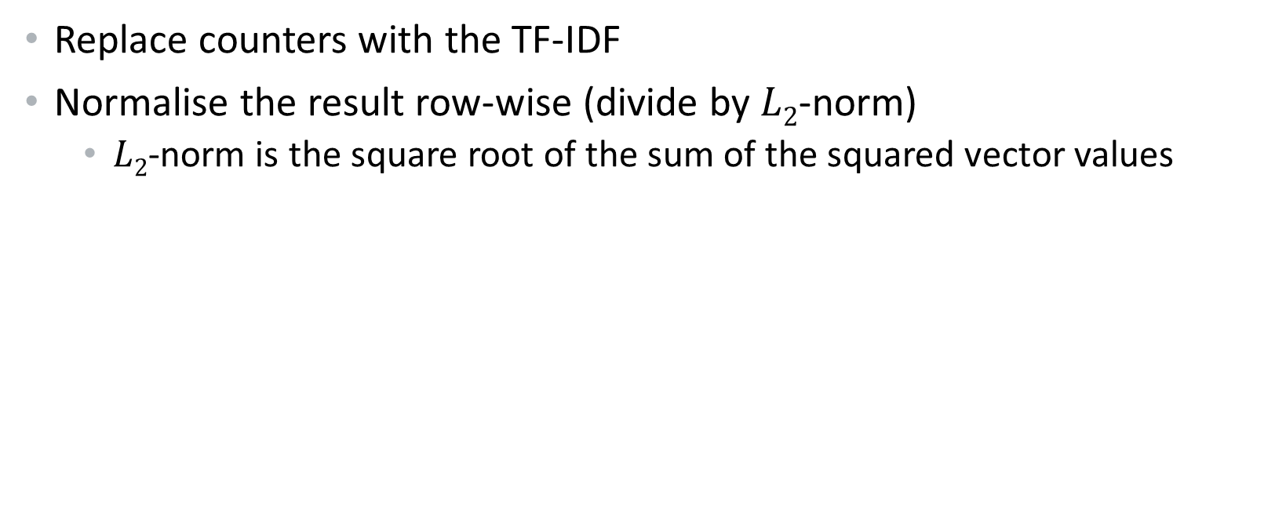
Improving the Bag of Word model
Replace counters with the TF-IDF
Normalise the result row-wise (divide by $L2$-norm)
$L2$-norm is the square root of the sum of the squared vector values

Slide 38
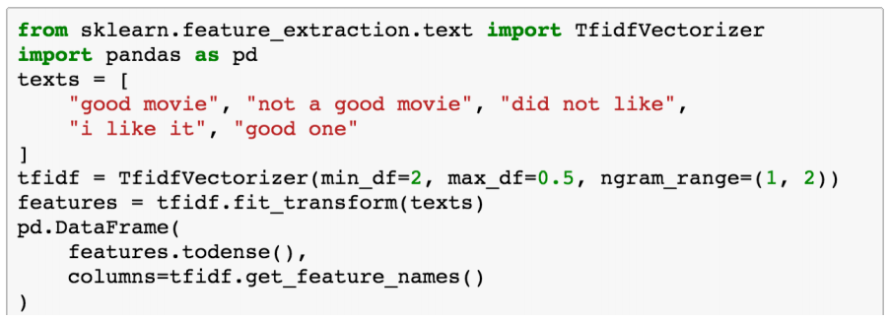
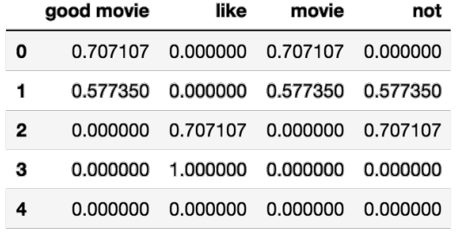
TF-IDF Python example

Slide 39
Limitations of Bag of Words model
Meaning:
Discarding word order ignores the context, and in turn meaning of words in the document (semantics)
Vocabulary:
The vocabulary needs careful design to manage the size, which impacts the sparsity of the document representations.
Sparsity:
Sparse representations are harder to model both for computational reasons (space and time complexity) and also for information reasons,

Slide 40



5-10 minutes break & Question Time Next: Word Embedding Models

Slide 41
Dense Vector Representation

Slide 42
Word Embedding Models
An alternative to BoW models is the dense vector representations known as word embedding models e.g. Word2Vec, Glove
Real-values vector representation is learned from a corpus of text
A word is a represented by a low dimensional vector
Similar words have similar vectors
Models capture semantic and syntactic details
Can be used as input to machine learning

Slide 43
Word2Vec Architecture
Uses a neural network model to learn word associations from a large corpus of text
It can detect synonymous words or suggest additional words for a partial sentence.
Represents each distinct word with a particular list of numbers called a vector.
Cosine similarity between the vectors indicates the level of semantic similarity between the words represented by the those vectors

Slide 44
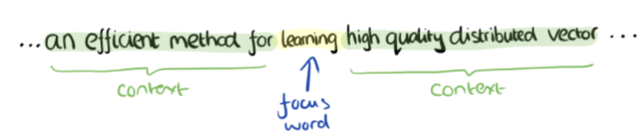
Word2Vec - CBOW
An efficient method for learning high-quality distributed vectors
Goal: Predict word given the context
Efficient Estimation of Word Representations in Vector Space: https://arxiv.org/pdf/1301.3781.pdf

Slide 45
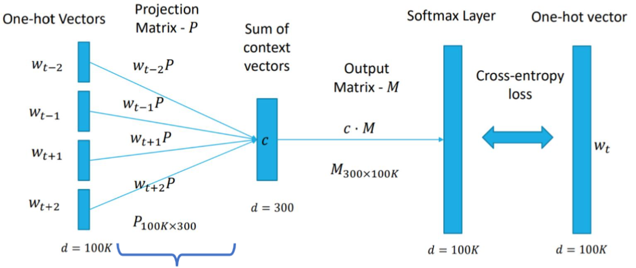
Word2Vec - CBOW
An efficient method for learning high-quality distributed vectors
Goal: Predict word given context
Embedding Matrix
Efficient Estimation of Word Representations in Vector Space: https://arxiv.org/pdf/1301.3781.pdf

Slide 46
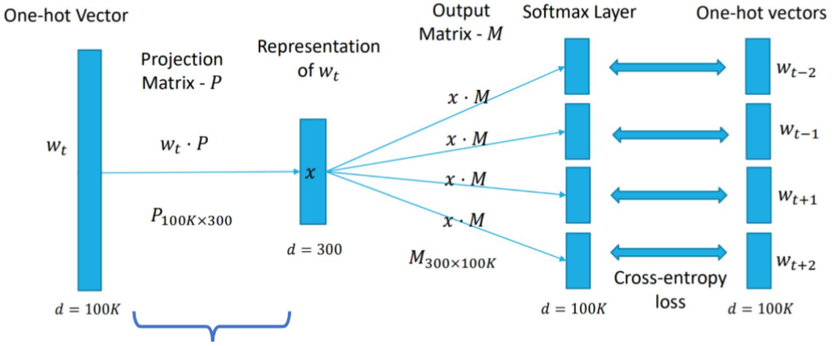
Word2Vec – Skip-Gram
Skip-gram: another architecture for training
Goal: Predict context given word
Embedding Matrix
Efficient Estimation of Word Representations in Vector Space: https://arxiv.org/pdf/1301.3781.pdf

Slide 47
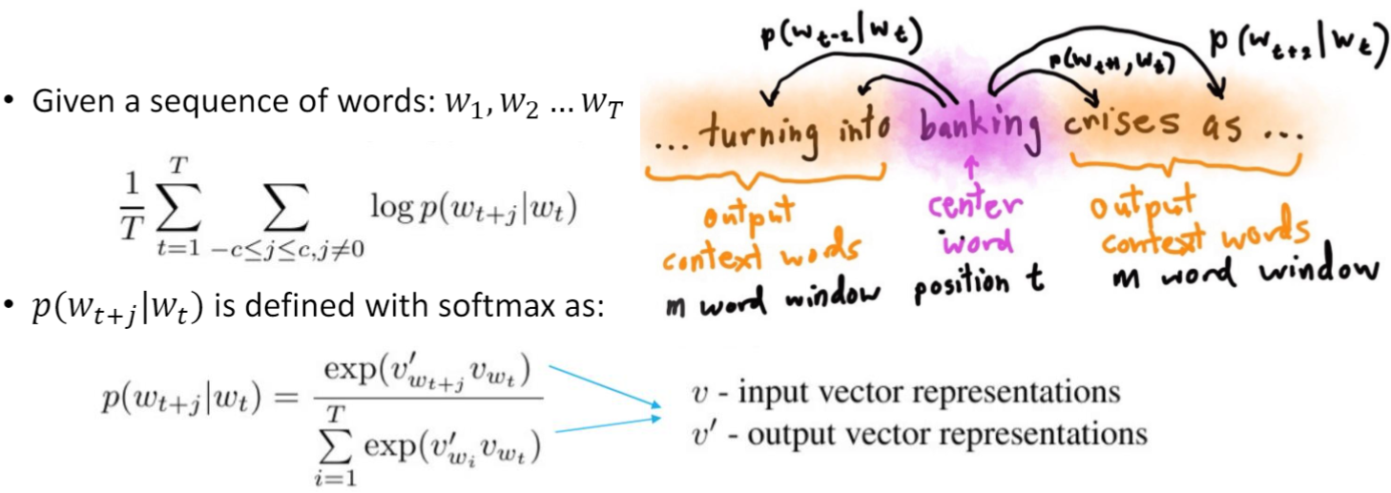
Word2Vec Definition
Implementations applies techniques like negative sampling and hierarchical softmax to achieve better results and training efficiency (see links for details)

Slide 48
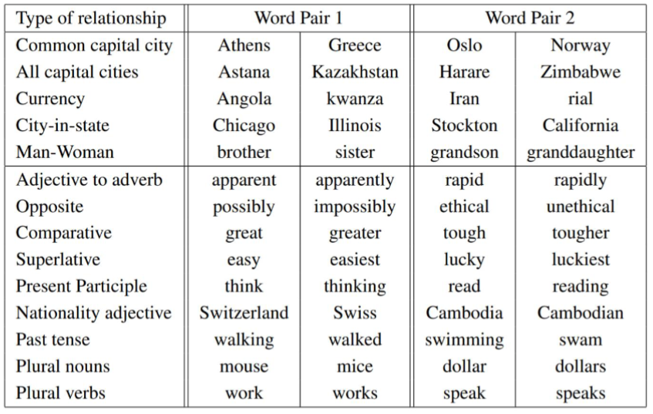
Word2Vec - Evaluation
Two intrinsic evaluation categories: semantic and syntactic
5 Semantic types
8869 questions
9 Syntactic types
10675 questions
https://arxiv.org/pdf/1301.3781.pdf

Slide 49
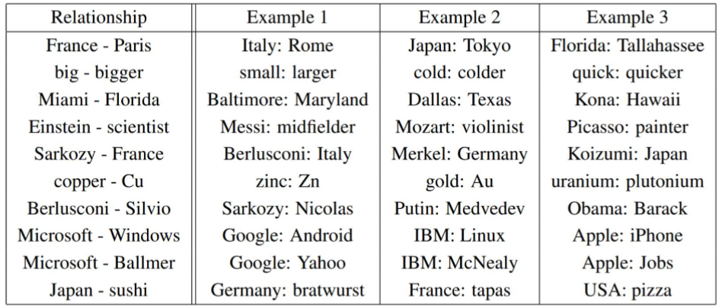
Word2Vec - Evaluation
Learned relationships
Word-pair
https://arxiv.org/pdf/1301.3781.pdf

Slide 50
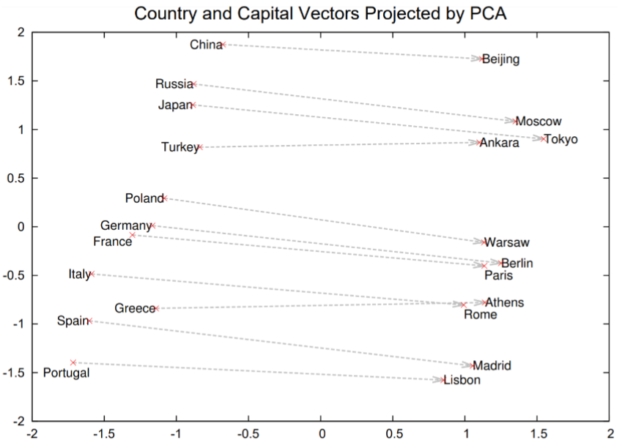
Word2Vec - Evaluation
Learned relationships
Word-pair
Countries and their capitals
https://arxiv.org/pdf/1301.3781.pdf

Slide 51
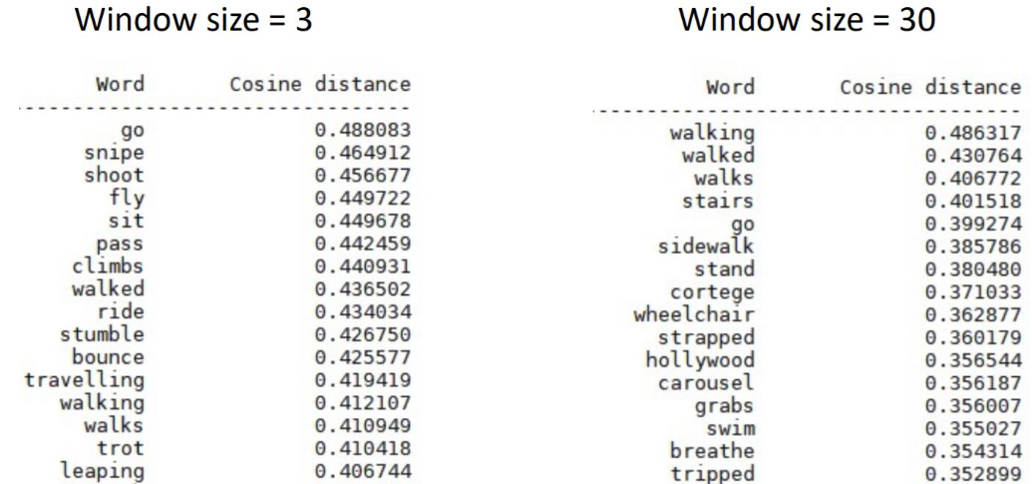
Training Parameters – Window size
Walk

Slide 52
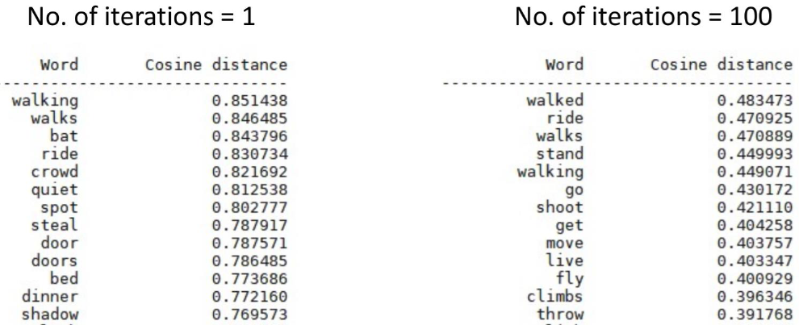
Training Parameters – Epochs (iterations)
Walk

Slide 53
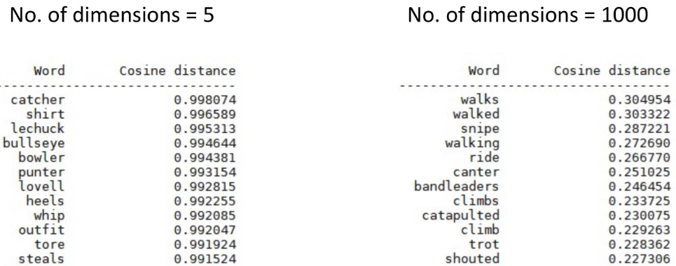
Training Parameters – dimensions
Walk

Slide 54
Other Type of Embedding Models
Character models - Karpathy(2015):
The Unreasonable Effectiveness of Recurrent Neural Networks
Subword models - Bojanowski(2017):
Enriching Word Vectors with Subword Information -ACL
Contextualised models:
BERT (Bidirectional Encoder Representations from Transformers)
ELMO (Embeddings from Language Model)

Slide 55
Other Type of Embedding Models
Sentence/Paragraph/Document models:
Le & Mikolov(2014): Distributed Representations of Sentences and Documents
Logeswaran & Lee (2018): An efficient framework for learning sentence representations
Thomas Wolf (2018):
The Current Best of Universal Word Embeddings and Sentence Embeddings

Slide 56
Review of Last Week Lab

Slide 57
Coming next…
Labs (Wednesday and Thursday):
Support for course work – use the lab sessions to ask all your questions on the coursework
Coursework deadline:
Endeavour to hand-in your coursework before the deadline

Slide 58
Thank you for attending, any questions?

